Slide 1
DATAKON'26
DSBS STUDENTS ASSOCIATION SRMIST ·
DATAVIZ
CampusPulse: Smart Campus Operations
Team: ShadowStack | Members: Kabir Singh Chadha, Viraj Singh Bhadouria
Problem statement: Problem 5: CAMPUSPULSE
8 October 2026 · SRMIST Kattankulathur
Notes:
Introduce the team and the problem we chose: CampusPulse, smart campus operations at SRMIST.

Slide 2
Problem statement
SETUP
The problem we chose
Questions we answer
SRMIST faces severe operational bottlenecks during class transition windows (08:00–18:00), spanning canteen queue inflation, transit shuttle overcapacity and gate vehicle gridlock.
What primary operational bottlenecks drive 67%+ of critical campus congestion incidents?
How can dynamic resource reallocation eliminate transit deficits without buying new shuttles?
What three data-driven interventions will restore campus satisfaction above 3.5/5.0?
Why it matters: peak canteen queues exceed 158 students and shuttle occupancy hits 139% overcapacity, driving student satisfaction to critical lows (r = −0.841 with queue length).
DATAKON'26 · DATAVIZ · DSBS, SRMIST
02
Notes:
State the problem and the three questions the dashboard answers.

Slide 3
Dataset overview
SETUP
12,000
20
08:00–18:00
Satisfaction
Rows
Columns
Time period
Key metric
Cleaning and preparation
Missing values and duplicates: imputed 96 missing Weather records with the mode ('Clear'), 120 Student_Satisfaction and 72 Vehicle_Count nulls with the median; 0 duplicate records found.
Columns created or transformed: extracted Hour, Minute and Decimal_Time; calculated Shuttle_Deficit = Shuttle_Demand − Shuttle_Capacity.
Filters or aggregations applied before charting: 15-minute slot logs grouped into hourly zone operational indices.
DATAKON'26 · DATAVIZ · DSBS, SRMIST
03
Notes:
12,000 rows, 20 columns, 15-minute intervals from 08:00 to 18:00 across weekdays and weekends. Key metrics: Student_Satisfaction, Congestion_Level, Shuttle_Occupancy_Pct, Canteen_Queue_Length.

Slide 4
Approach and tools
ANALYSIS
01
02
03
04
Clean
Explore
Visualize
Interpret
Imputed nulls; parsed times into Hour
Footfalls, correlations, peak spikes
Bars, scatter trendlines, Sankey, gauge
Three no-capex interventions
Tools used
Python, Pandas, NumPy, Plotly Express / Graph Objects, Streamlit, Antigravity IDE, GitHub
DATAKON'26 · DATAVIZ · DSBS, SRMIST
04
Notes:
Four steps: clean, explore, visualize, interpret. Correlations found: r = -0.841 (canteen queue vs satisfaction) and r = +0.838 (shuttle occupancy vs wait). Interventions: Ghost Kitchen Lockers, Predictive Fleet Balancing, Weather-Adaptive Micro-Staggering.

Slide 5
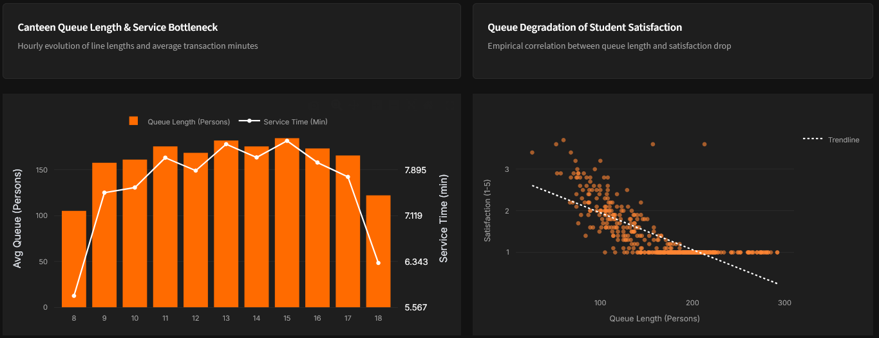
Visualization 1: Queues cut satisfaction
ANALYSIS
What it shows
Satisfaction falls from about 3.5 to a floor of 1.0 as queues pass ~150 people (r = −0.841).
Average queues hold at roughly 165–185 people from 11 AM to 5 PM; service time stays near 8 minutes.
A bar-plus-line view shows queue and service time by hour; a scatter with trendline shows the queue–satisfaction link.
DATAKON'26 · DATAVIZ · DSBS, SRMIST
05
Notes:
Left chart: hourly canteen queue and service time. Right chart: queue length against satisfaction. Satisfaction hits the floor of 1.0 beyond about 150 people.

Slide 6
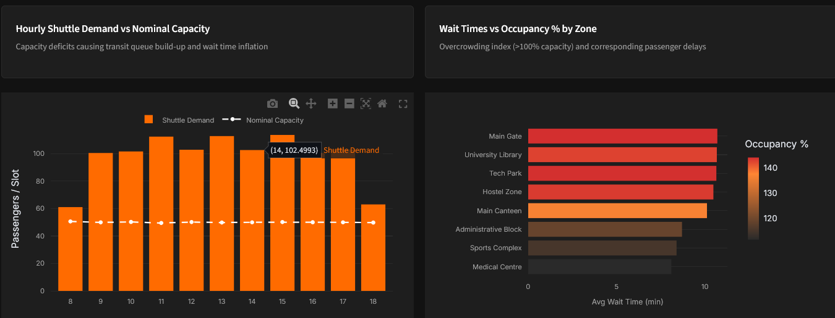
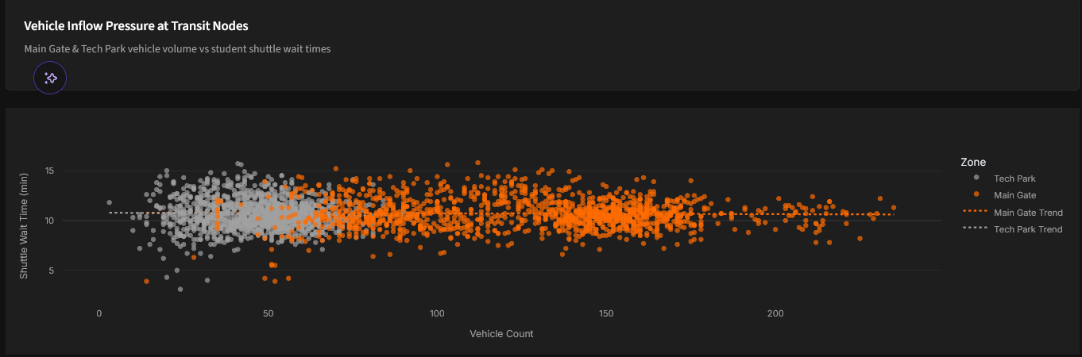
Visualizations 2 and 3
ANALYSIS
Demand is ~2× capacity; busiest zones hit ~140%
Vehicle counts differ 3×, but waits stay ~10 min
DATAKON'26 · DATAVIZ · DSBS, SRMIST
06
Notes:
Left: hourly shuttle demand vs the 50-seat capacity, and wait time by zone. Right: vehicle count vs wait time. The trendlines are flat, so waits do not rise with vehicle count.

Slide 7
Key insights
ANALYSIS
36.9%
139%
11 min
Insight 1
Insight 2
Insight 3
Dining bottleneck: canteen queue congestion accounts for 36.9% of all critical campus incidents; diverting 30%–40% of traffic recovers satisfaction above 3.50/5.0.
Transit deficit: fixed shuttle loops create a spatial mismatch, with 139% occupancy at Tech Park while Admin and Medical have near-zero unassigned demand.
Weather impact: rain lifts shuttle waits to 11.04 minutes, compounding 141 vehicles/hr of gate congestion during simultaneous class transitions.
DATAKON'26 · DATAVIZ · DSBS, SRMIST
07
Notes:
One number per card: 36.9% of critical incidents, 139% shuttle occupancy, about 11 minute rainy-day waits.

Slide 8
Interactivity and demo plan
LIVE DEMO
Interactive features
Demo flow
Filters: multi-zone selector, Weekday/Weekend toggle, 8 AM–6 PM hour slider.
Drill-downs: hover tooltips and zoom/pan on every Plotly chart.
Dynamic elements: Ghost Kitchen Diverter slider (0%–60%), Dynamic Fleet Redistribution checkbox, Weather Protocol selector.
Open the final visualization (Streamlit app, localhost:8501)
Apply a filter: Tech Park & Main Canteen at peak hour 12:00
Drill into: the shuttle wait-time gauge, after ticking “Enable Dynamic Fleet Redistribution”
Show the key insight live: wait times drop from 10.2 min to under 5 min
DATAKON'26 · DATAVIZ · DSBS, SRMIST
08
Notes:
Rehearse the four steps. Keep a backup screenshot of the gauge chart in case the live app fails.

Slide 9
Conclusion and recommendations
WRAP-UP
What we found
What to do next
Campus congestion at SRMIST is not an intractable capacity shortage, but an asynchronous scheduling and spatial distribution mismatch.
Decentralized locker pickup hubs: convert 40% of peak canteen orders into pre-packaged meal lockers at Tech Park & Library (cuts queues ~40%).
Predictive fleet balancing: re-route 40% of idle shuttles from Admin/Medical to Tech Park during the 11 AM–3 PM peak (waits under 5 min).
Weather-adaptive micro-staggering: stagger Tech Park dismissal bells by 12 minutes to cut gate vehicle spikes by 28%.
Limits: the dataset is synthetic, so effects are correlational and intervention gains are simulated estimates.
DATAKON'26 · DATAVIZ · DSBS, SRMIST
09
Notes:
Answer the problem statement, then the three recommendations. Close with the limits.

Slide 10
Thank you
DATAKON'26 · DATAVIZ
QUESTIONS?
Team: ShadowStack
Kabir Singh Chadha · Viraj Singh Bhadouria
DSBS Students Association · SRMIST
10
Notes:
Invite questions from the judges.

